Slide 1

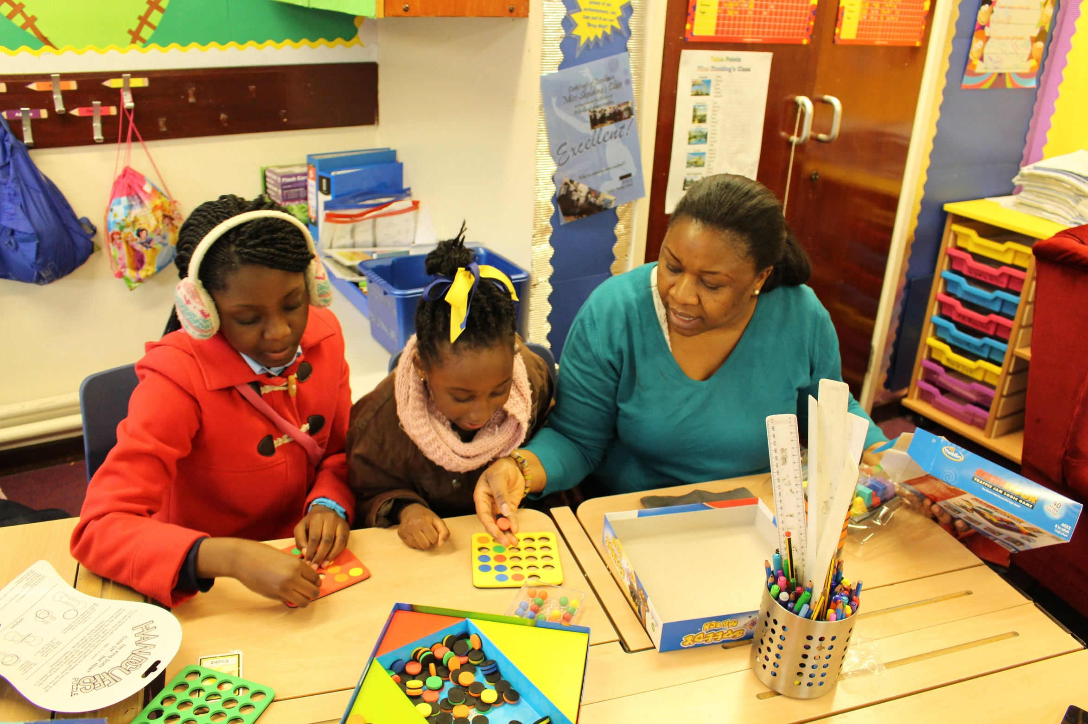


Help your child love maths!
Ishraq Li-Rahman
nationalnumeracy.org.uk

Slide 2

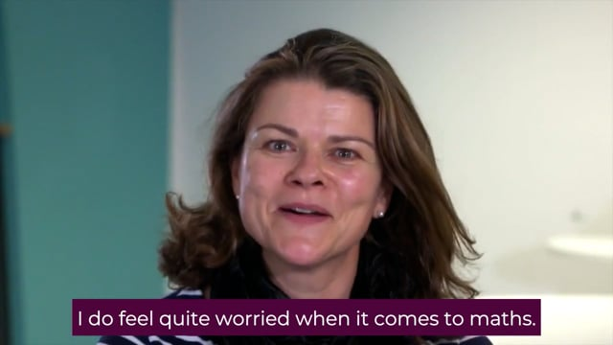
How do you feel about maths?
nationalnumeracy.org.uk
Notes:
https://www.youtube.com/watch?v=XZuert73Le0

Slide 3

What do other people say?
nationalnumeracy.org.uk

Slide 4








National Numeracy’s top tips for supporting children
Point out maths in the real world
Be positive about
maths
Praise effort rather than talent
Improve
your own confidence
nationalnumeracy.org.uk

Slide 5


Point out maths in the real world
nationalnumeracy.org.uk
nationalnumeracy.org.uk

Slide 6
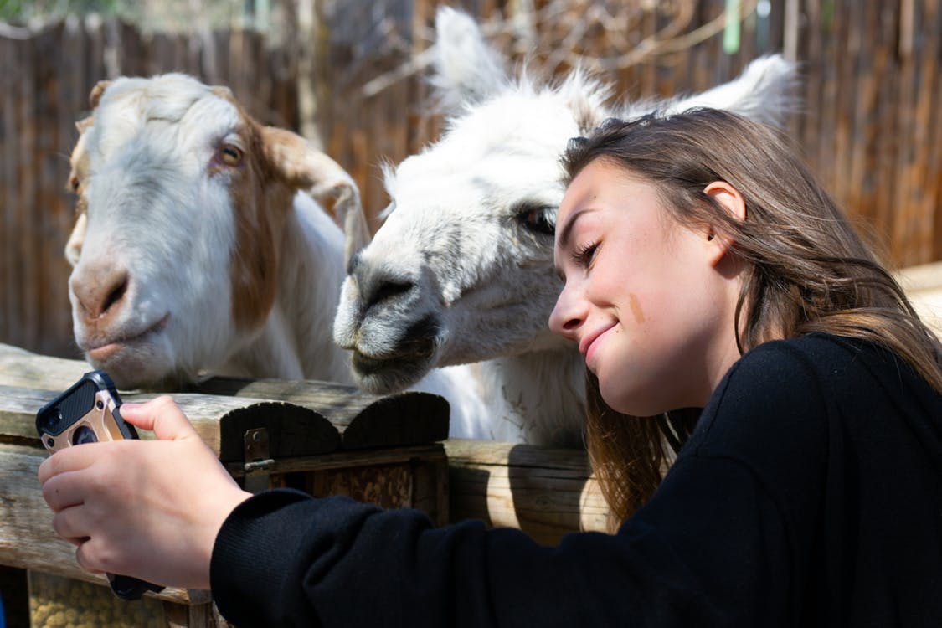


Point out maths in the real world
Consider a scenario from daily life
How are numbers involved?
What opportunities are there to point our numbers to your children?

Slide 7
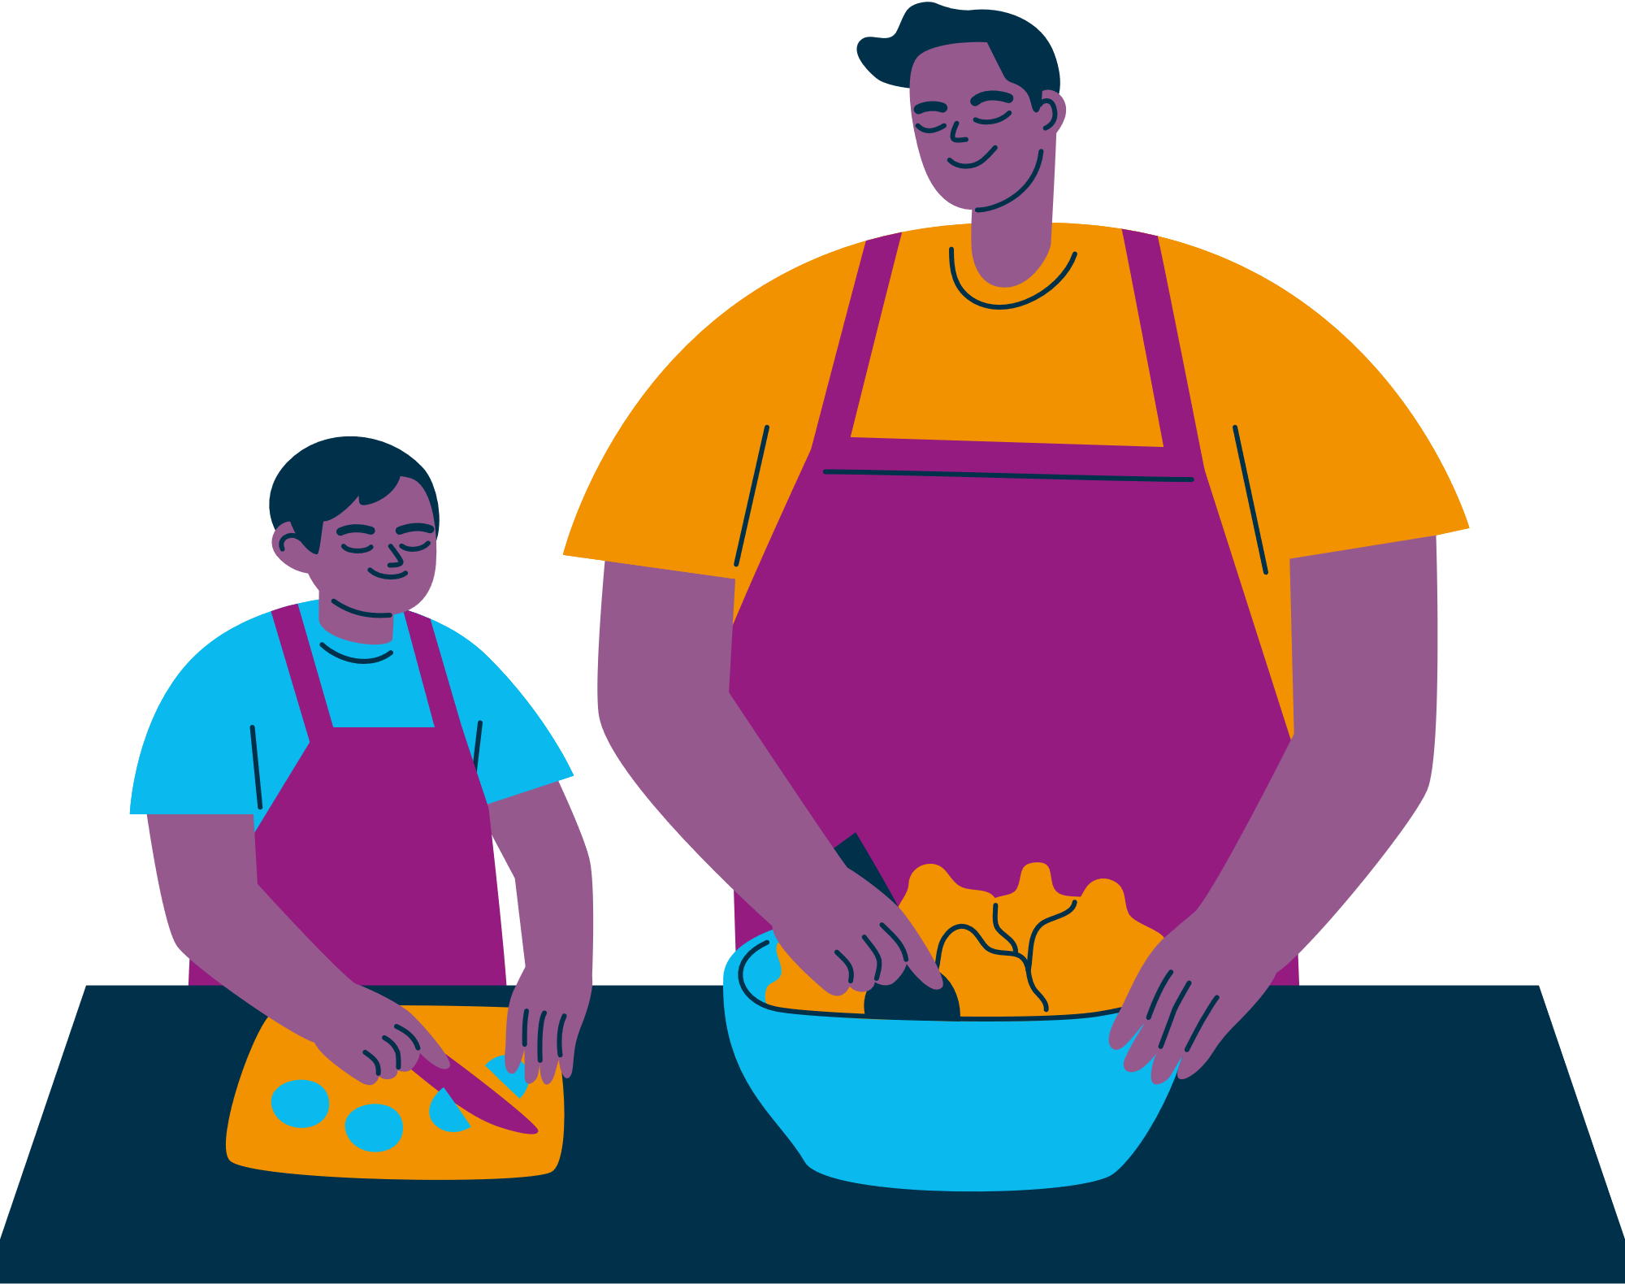
Point out maths in the real world
  Planning journeys
  Shopping
  Cooking
  D.I.Y.
  Reading the news
  Making financial decisions
nationalnumeracy.org.uk

Slide 8
Talking positively about maths
nationalnumeracy.org.uk
nationalnumeracy.org.uk

Slide 9
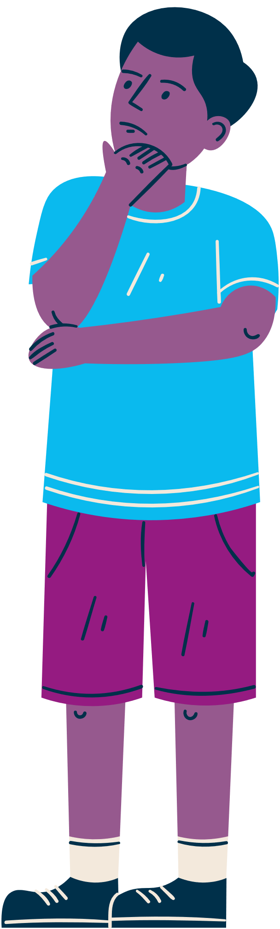
Here are some thing people sometimes say to children about maths.
Have you heard these things being said?
Why might these be unhelpful to say to children?
What could be said instead to encourage positive attitudes in children?
?
?
nationalnumeracy.org.uk

Slide 10


“I was never any good at maths at school and it did me no harm.”

Slide 11


“You won’t need to worry about maths once you’ve finished school.”
nationalnumeracy.org.uk

Slide 12


“I’ve always been good at maths; it comes naturally to me. I have a maths brain.”

Slide 13


“Well done for getting that right. You’re so clever.”
nationalnumeracy.org.uk

Slide 14
Praise effort rather than talent
nationalnumeracy.org.uk

Slide 15


Praise effort rather than talent
Praising Talent
Praising Effort
“Well done, you’re so clever.”
“You’re naturally really good at this.”
“It’s amazing that maths is so easy for you.”
“Well done for working so hard at that.”
“You’ve learned so much, well done.”
“It’s great that you kept going with that even when it was tricky.”
nationalnumeracy.org.uk

Slide 16
Growth Mindset
Fixed Mindset
Growth Mindset
Talent is innate
Some people just can’t do certain things
There is no point in trying to improve if you aren’t born with the ability
Ability is not fixed
You can learn and improve at anything is you put enough time and effort into it
If you put your mind to it, you will be able to improve: ability isn’t something you’re born with
nationalnumeracy.org.uk

Slide 17
Improve your own confidence
nationalnumeracy.org.uk

Slide 18

The National Numeracy Challenge
Focuses on everyday maths.
Includes multiple choice questions with an option for ‘I don’t know.’
Has no time limits.
Takes up to an hour to complete.
Allows learners to log
in & out at any time during the assessment and save their progress.
Adapts to the learner’s level.
Praising Talent
nationalnumeracy.org.uk

Slide 19
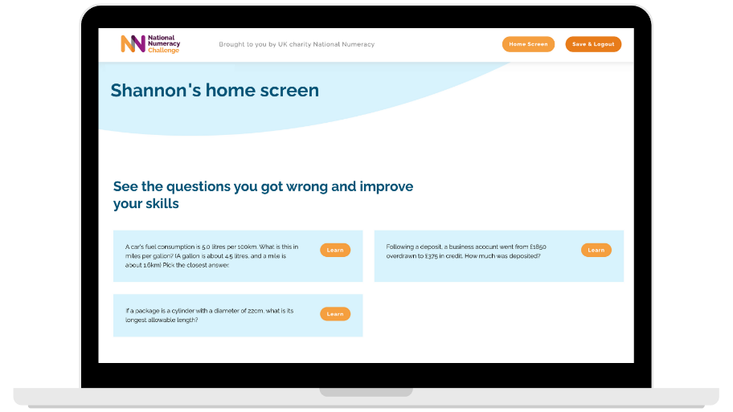
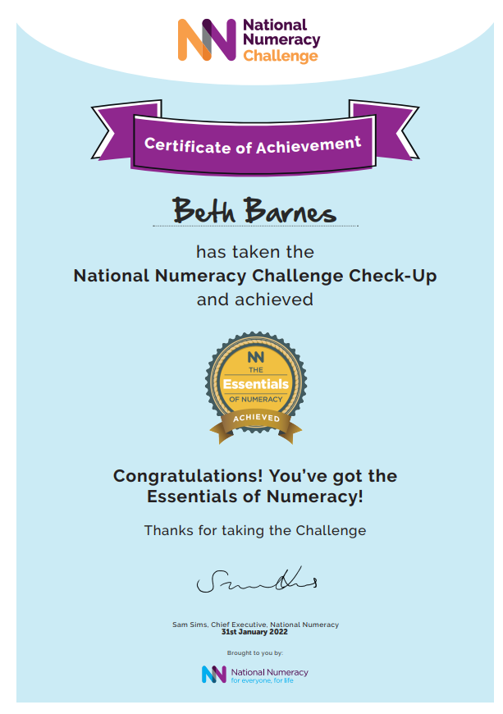
The National Numeracy Challenge
Linked to the questions the learner got wrong
Selected at the right level
Provide choice for learners
Available on mobile
Can be worked through independently
Designed for those with the lowest confidence
nationalnumeracy.org.uk

Slide 20

The National Numeracy Challenge
Notes:
https://www.youtube.com/watch?v=XZuert73Le0

Slide 21
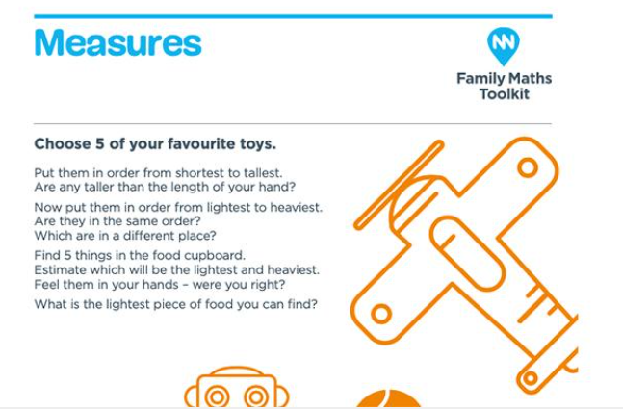
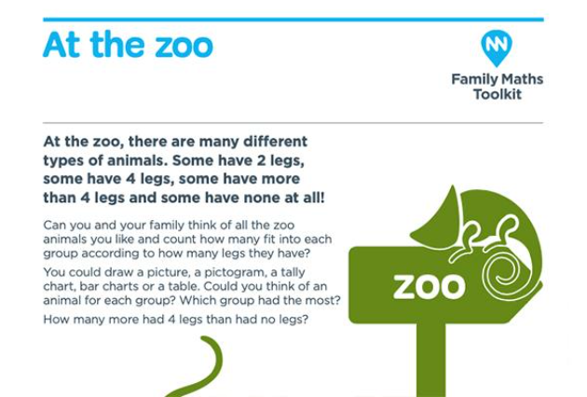
Family Maths Toolkit
Over 200 ‘everyday maths’ activities for children and their families to do together
Reception and Years 1 – 6
Weekly maths challenge to complete outside of school with their family
Activities are linked to objects around the home, school calendar and cultural events
Aligned to the 2014 National Curriculum

Slide 22
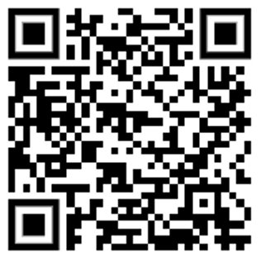

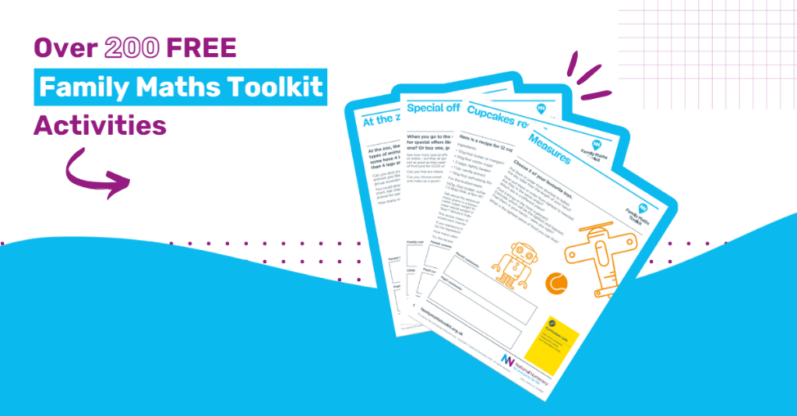
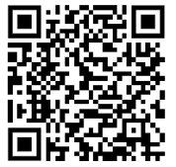
www.nationalnumeracy.org.uk/challenge/wscc
Technical Support: support@nnchallenge.org.uk
https://www.nationalnumeracy.org.uk/free-family-maths-toolkit

Slide 23


Thank you!
Any questions?
ishraq@nationalnumeracy.org.uk
Please complete the feedback form
nationalnumeracy.org.uk

