Slide 1

Growth Mindset
St Mark’s CEP School 2020

Slide 2

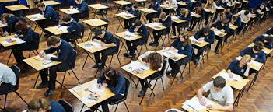



We are in a ‘test’ based culture
Notes:
Career specific qualification
Degrees/ Hons, Masters, PHDs
A Levels
GCSE’s
KS3 progress tests
KS2 tests
Year 4 times tables
Baseline assessment
KS1 tests

Slide 3
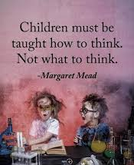
Our Aims As A School
To develop our children as learners…

Slide 4

Quite simply, we want the children to succeed in whatever they choose to do in life.
We want them to be happy, determined, resilient, independent thinkers with the skills set and confidence to set a goal and strive to meet it.

Slide 5
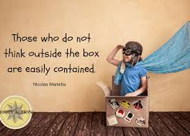
‘We are a product of our thoughts…’
https://www.youtube.com/watch?v=v-Dn2KEjPuc

Slide 6
So far so good…
Topic based curriculum
Rich Text
STEM challenges
Chilli Challenges
Check Points
Creative curriculum
Increased focus on reasoning and explanations

Slide 7
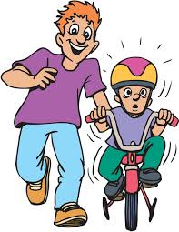
Riding a bike: the learning challenge analogy
Comfort Zone/
current ability – upper limit of what you can do now
Wobble Zone (proximal development)
Practice Zone getting more confident – not ‘better’
Subconscious Ability - can do it without thinking
Potential Ability – beyond what you can do comfortably

Slide 8
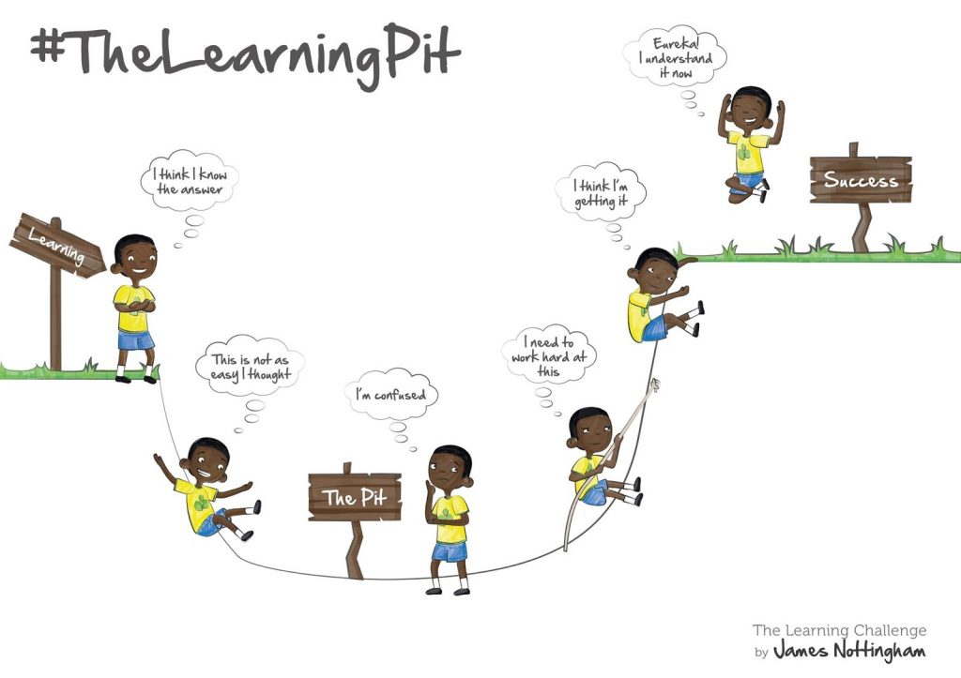
The Pit!

Slide 9

Next steps
Growth Mindset
The Pit
Understanding how we learn
Independence
Recognising what needs to be done
Being accountable
Resilience
Understanding the value of mistakes
Having another go

Slide 10

Step 1
The Pit
https://www.youtube.com/watch?v=3IMUAOhuO78

Slide 11
Our hope
Is that the children start to get this…
They see having a go is the best way to get started
They understand that ‘easy’ is not learning
That they develop a sense of pride when they know they have really tried hard
That ‘eureka’ moments really mean something to them
They are confident
They are independent
They think
They problem solve
They see that the effort they put in is related to what they get back

Slide 12
How are we going to do this? Change the children’s attitude
Shift in language directly relating to attitude:
  I can’t do it vs. I can’t do it yet
  It’s too hard vs. this is a challenge
  I can’t so I won’t vs. how can I get started?
Focus on praising effort
Children showing their mistakes and showing an awareness of the learning process
Changing perception of ‘first to finish’ and ‘best in class’
Combining the challenge of the curriculum with creative teaching and rich experiences for the children so they can experience a love of learning.

Slide 13
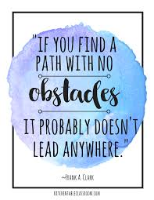
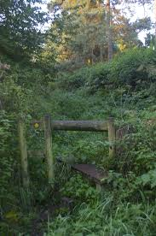

Slide 14
The Key Messages
It is ok to make mistakes
Have a go
Think for yourself
Keep trying
Don’t measure your success against others
Accept no one is perfect
Do your best
Be proud of your achievements

Slide 15
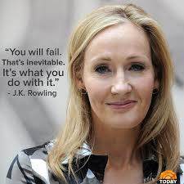
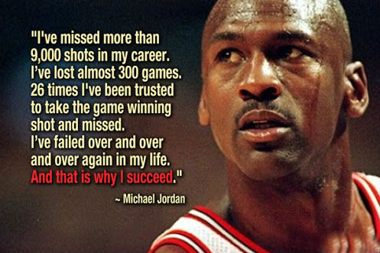
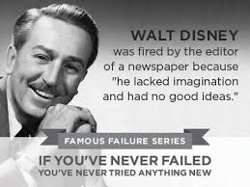
How you can help.
Support the growth mindset process
Talk openly about how you have learnt from mistakes
Use language carefully e.g.
10/10 in spellings – well done for working hard to learn those words
You are right, this is hard. How can you make a start on…

Slide 16
When you don’t give up you cannot fail.
https://www.youtube.com/watch?v=V93-mOwkw3I

Slide 17
Any questions

